Slide 1
Supervised learning
Ali Madani
Farnoosh Khodakarami

Slide 2
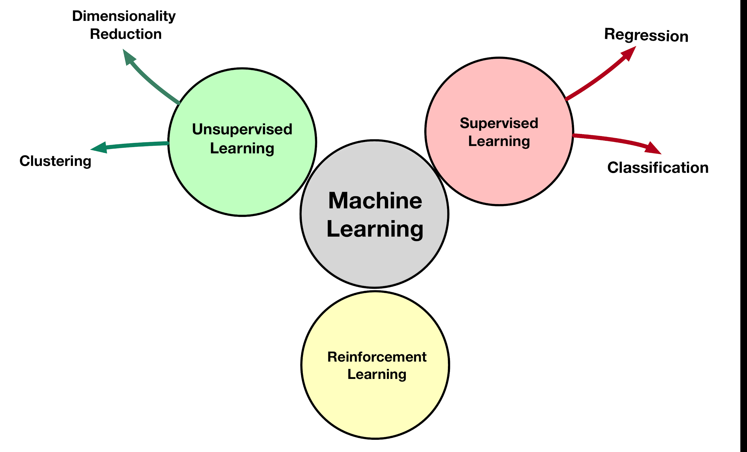
Notes:
In supervised learning,
we're going to teach the computer how to do something.
in unsupervised learning,
we're going to let it learn by itself.
we only have input data, we don't have any labels to go with the data.
Reinforcement learning is an important type of Machine Learning where an agent learn how to behave in a environment by performing actions and seeing the results.

Slide 3
Supervised vs Unsupervised Learning
Unsupervised Learning
No Knowledge of output
data is unlabeled
Self guided learning
Goal: determine data patterns/grouping
Supervised Learning
Knowledge of output
data is labeled with class or value
Goal: predict value label or class label

Slide 4
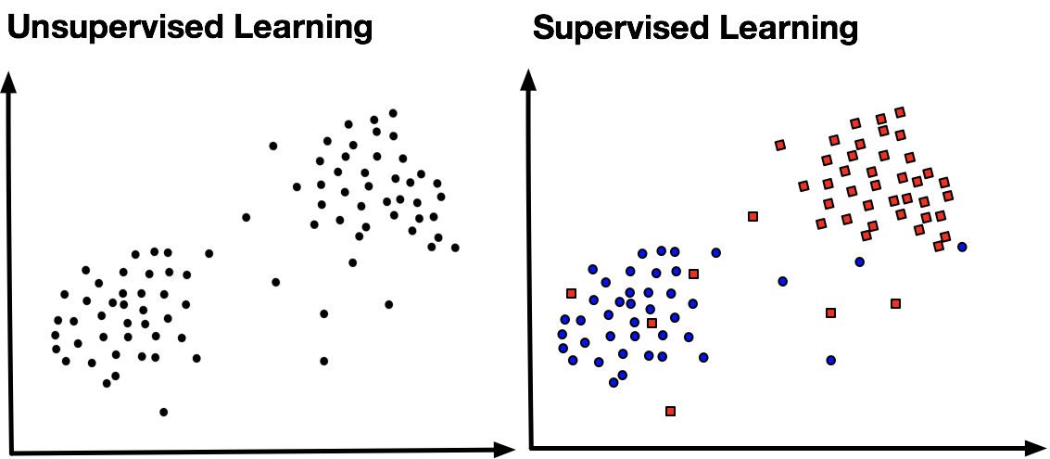

Slide 6
Notes:
In supervised learning,
we're going to teach the computer how to do something.
in unsupervised learning,
we're going to let it learn by itself.
we only have input data, we don't have any labels to go with the data.
Reinforcement learning is an important type of Machine Learning where an agent learn how to behave in a environment by performing actions and seeing the results.

Slide 7
Machine Learning Algorithms

Slide 8



K Nearest Neighbor

Slide 9
K Nearest Neighbor
Can be used both for classification and regression.
Uses feature similarity to predict values of any new data points.
The output based on the majority vote (for classification)
or mean (or median, for regression)
Notes:
by a simple majority vote.

Slide 10
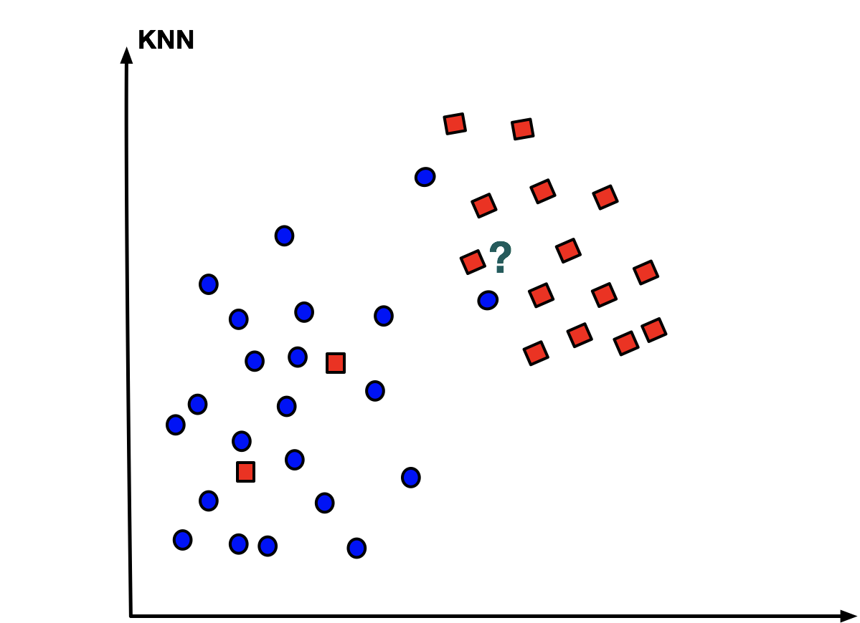
K Nearest Neighbor
Pick a value k
Use x’s K-Nearest Neighbors to vote on what x’s label should be.

Slide 11
K Nearest Neighbor
hight
3 nearest neighbours
Gymnast
Basketball player
weight

Slide 12
K Nearest Neighbor
hight
5 nearest neighbours
Gymnast
Basketball player
weight

Slide 13
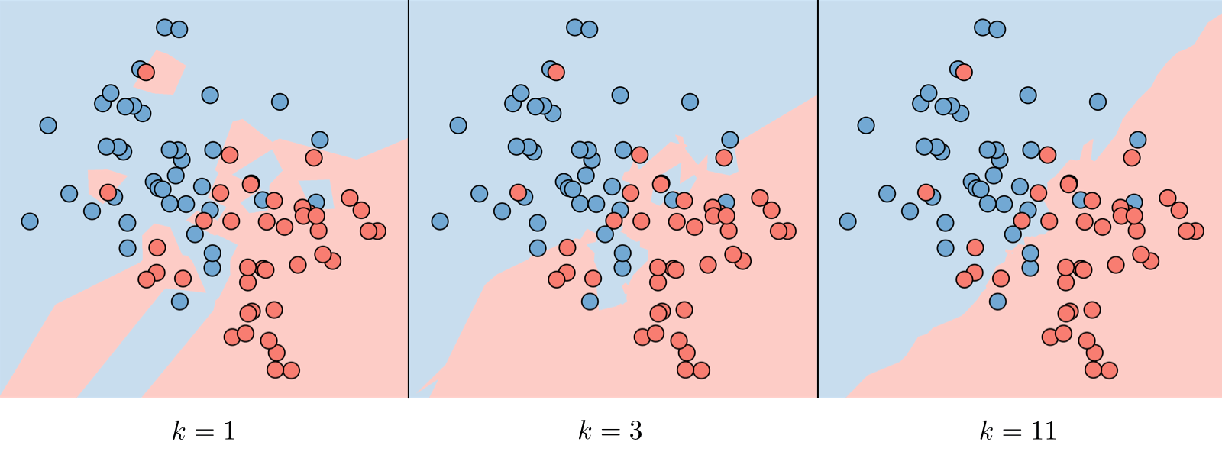
K Nearest Neighbor
https://stanford.edu/~shervine/teaching/cs-229/cheatsheet-supervised-learning

Slide 14



Iris DataSet
Iris virginica
Iris setosa
Iris versicolor
Sepal
Petal
https://ca.wikipedia.org/wiki/Conjunt_de_dades_de_flors_Iris

Slide 15
Linear Regression

Slide 16
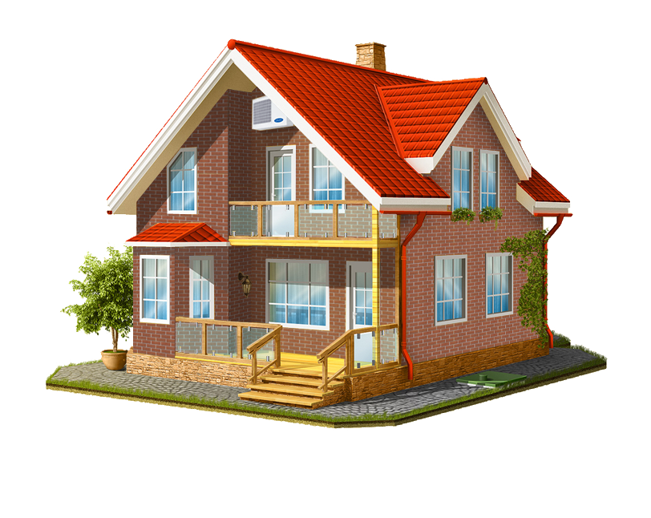

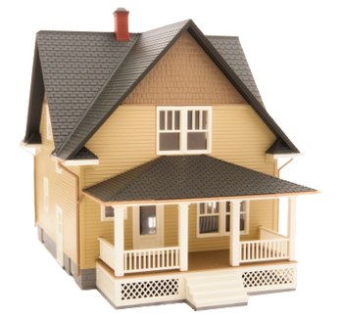
3M
Price
1M
?

Slide 17
Linear Regression
Linear regression is the simplest and most widely used statistical technique
A linear model expresses the target output value in terms of a sum of weighted input variables.

Slide 18
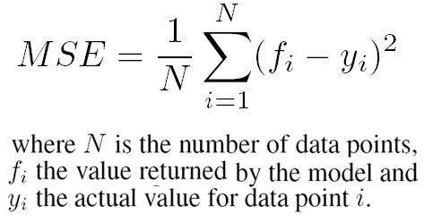
Linear Regression
y
f_{i} = w₀x_{i}+b₀
700
600
500
Mean squared error
400
Price of the house
300
200
x
100
500
1000
1500
2000
2500
Size of the house feet²

Slide 19
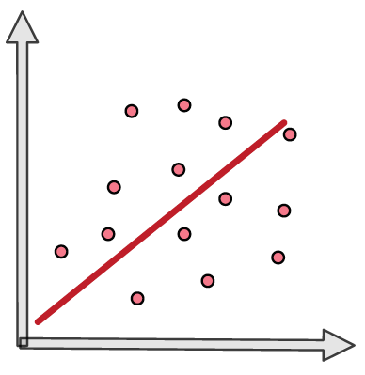
Univariate versus Multivariate Modeling
Univariate
Output
f_{i}=w₀x_{1i}+b₀

Slide 20
Univariate versus Multivariate Modeling
Univariate
Multivariate
Output
Output
f_{i}=w₀x_{1i}+b₀
f_{i}=w₀x_{1i}+b₀
+w₁x_{2i}+b₀
_{+.....}
+w₁x_{mi}+b₀

Slide 21
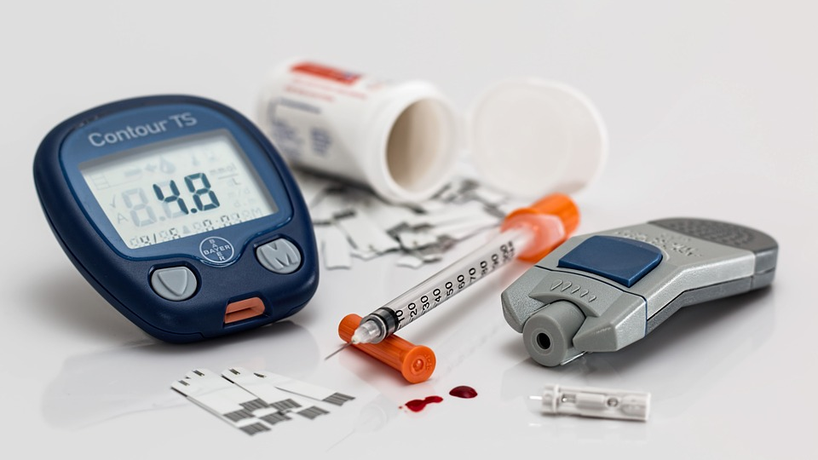
Diabetes
Ten baseline variables:
age, sex, body mass index, average blood pressure, and six blood serum measurements
n = 442 diabetes patients
Target value:
A quantitative measure of disease progression one year after baseline.

Slide 22
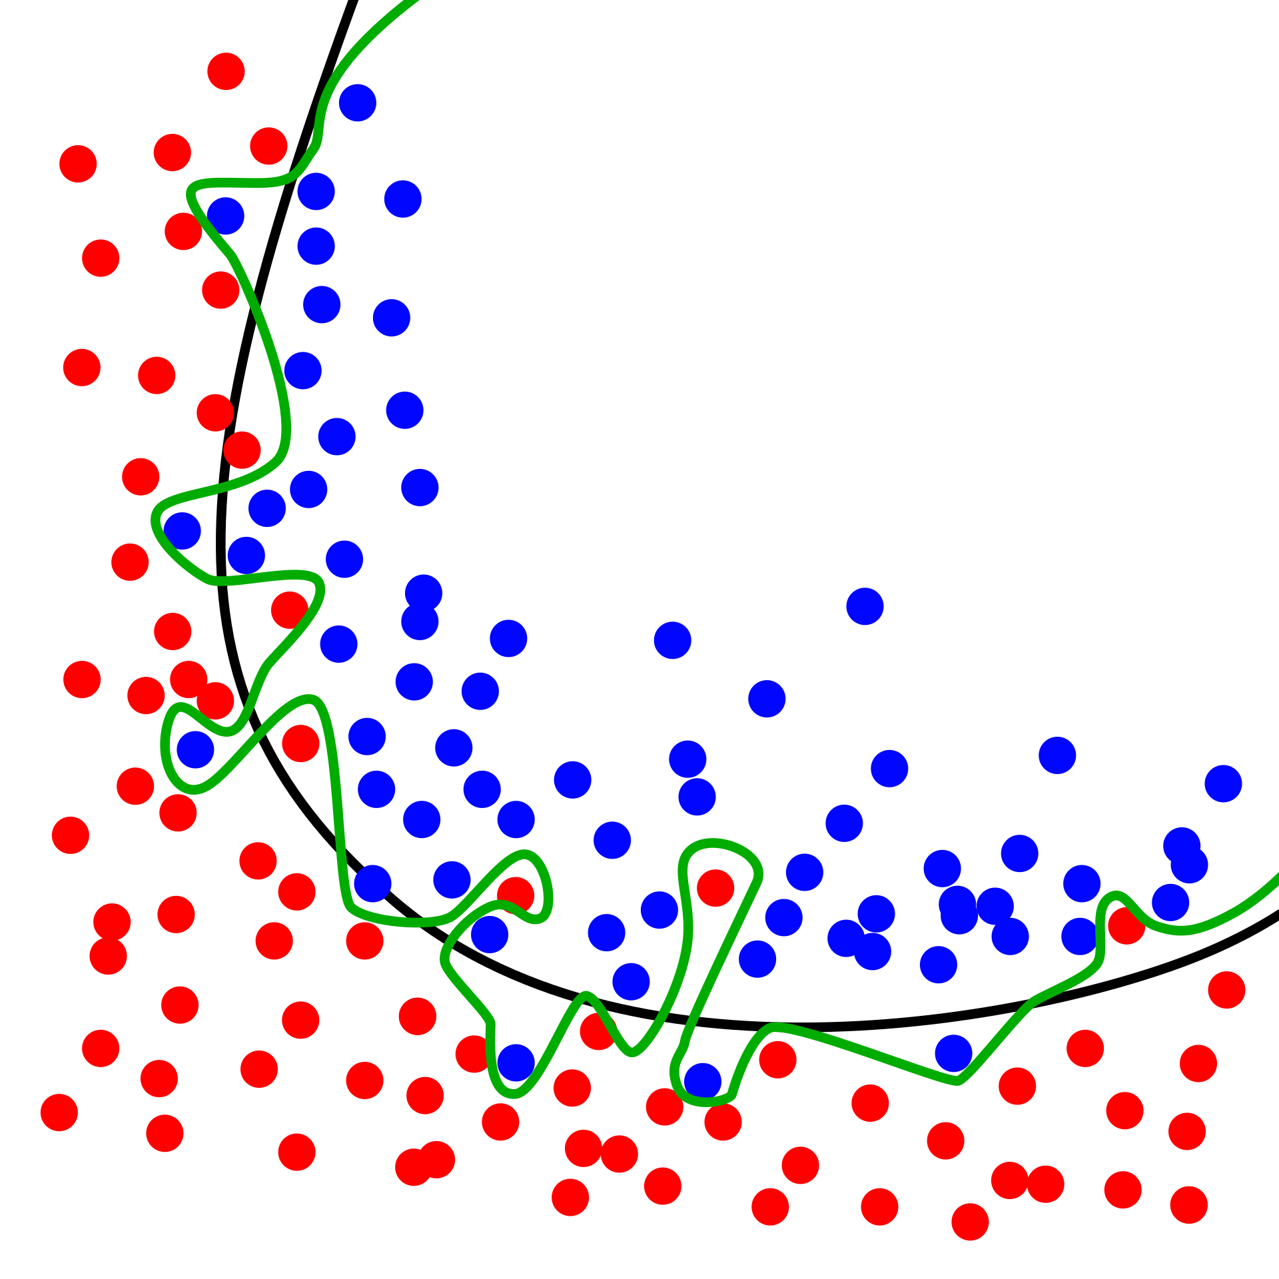
Overfitting
Overfitting: Good performance on the training data, poor generalization to other data.
Underfitting: Poor performance on the training data and poor generalization to other data
Image source wikipedia

Slide 23
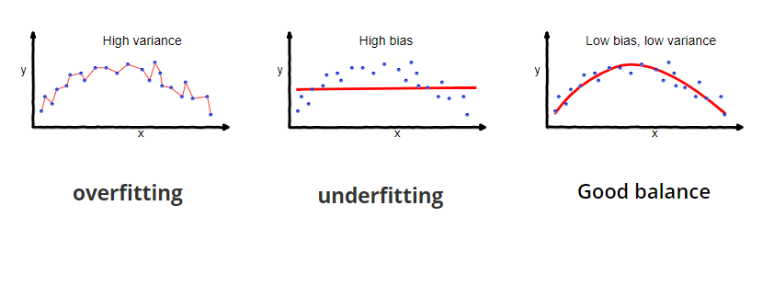
Bias–Variance Tradeoff

Slide 24
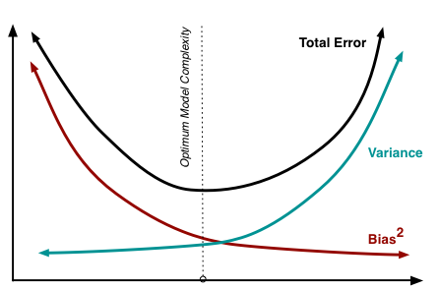
Bias–Variance Tradeoff
Error
Model complexity

Slide 25
Logistic Regression

Slide 26
Linear versus Logistic Regression
Regression (linear regression)
y
Regression line
x

Slide 27
Linear versus Logistic Regression
Regression (linear regression)
Classification (logistic regression)
y
Regression line
y
x
x

Slide 28
Linear versus Logistic Regression
Regression (linear regression)
Classification (logistic regression)
y
Regression line
y
x
x
We need a smooth function that gives us this trend (Sigmoid Function)

Slide 29
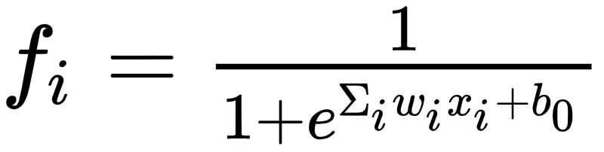
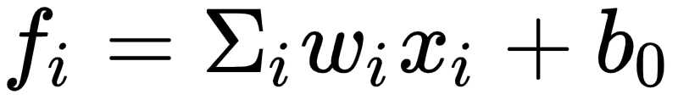
Linear versus Logistic Regression
Linear regression
Logistic regression
W will be identified to minimize cost
Cost(w)=function(w,f_{i},y_{i})

Slide 30
Bayes rule and Naive Bayes classifier

Slide 31
What we know when training a model
Class=1
p(X1=x1|Class=1)
Class=2
p(X2=x2|Class=1)
p(Xm=xm|Class=1)

Slide 32
What do we care about?
Class=1
Class=2
p(Class=1|X1=x1,X2=x2,…,Xm=xm)=?
?

Slide 33
Bayes rule is useful to figure out the relationship
p(A|B)p(B)=p(B|A)p(A)
p(Class=1|X1=x1,X2=x2,…,Xm=xm)*
p(X1=x1,X2=x2,…,Xm=xm)=
p(X1=x1,X2=x2,…,Xm=xm|Class=1)p(Class=1)

Slide 34
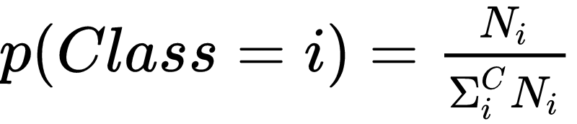
The relationship looks complicated
WWW*p(X1=x1,X2=x2,…,Xm=xm)=
p(X1=x1,X2=x2,…,Xm=xm|Class=1)p(Class=1)
WWW: What We Want
p(Class=1):easy to calculate

Slide 35
Naive Bayes
Naive Bayes classifier is called Naive as it assumes each feature will independently contribute in prediction of a class for each data point
p(X1=x1,X2=x2,…,Xm=xm)=p(X1=x1)p(X2=x2)...p(Xm=xm)
p(X1=x1,X2=x2,…,Xm=xm|Class=1)=
p(X1=x1|Class=1)p(X2=x2|Class=1)...p(Xm=xm|Class=1)

Slide 36
Bayesian approach for problem solving

Slide 37
Bayesian versus frequentist
Frequentist:
Variation of data and derived quantities in terms of fixed model parameters
Bayesian:
Variation of beliefs about parameters in terms of fixed observed data
Note. The difference become clear in complicated problems like Interpretation of uncertainty.

Slide 38
Bayesian versus frequentist
Frequentist:
If an experiment is repeated many times, in 95% of these cases the computed confidence interval will contain the true theta.
Note. In general, a frequentist 95% confidence interval is not 95% likely to contain the true value. This very common mistake is a Bayesian interpretation of a frequentist construct.

Slide 39
Bayesian versus frequentist
Frequentist:
If an experiment is repeated many times, in 95% of these cases the computed confidence interval will contain the true theta.
Note. In general, a frequentist 95% confidence interval is not 95% likely to contain the true value. This very common mistake is a Bayesian interpretation of a frequentist construct.
Bayesian:
Given our observed data there is a 95% probability that the value of theta lies within the credible region

Slide 40
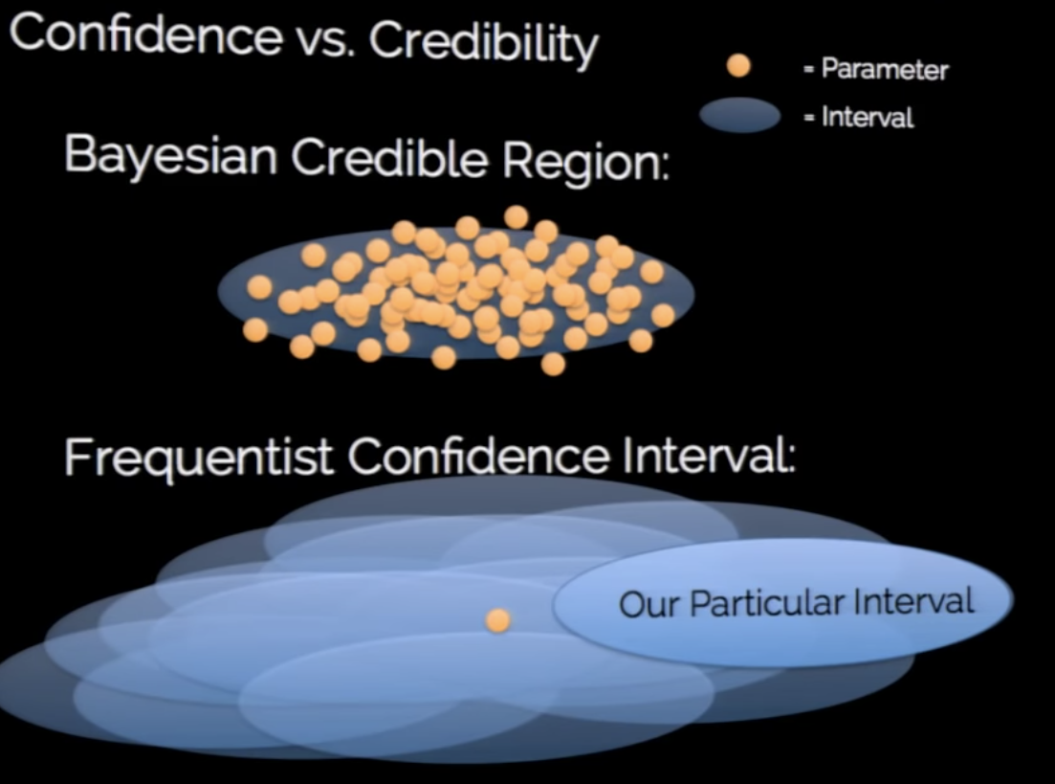
https://speakerdeck.com/jakevdp/

Slide 41
Conversation between a (frequentist)statistician and a scientist:
Statistician:
95% of such confidence intervals in repeated experiments will contain the true value. (Referring to chance in that context is meaningless. The 95% refers to the interval itself)
The long term limiting frequency of the procedure or constructing this interval ensures that 95% of the resulting ensemble of intervals contains the value.
Scientist:
So there is a 95% chance that the value is in this interval?

Slide 42
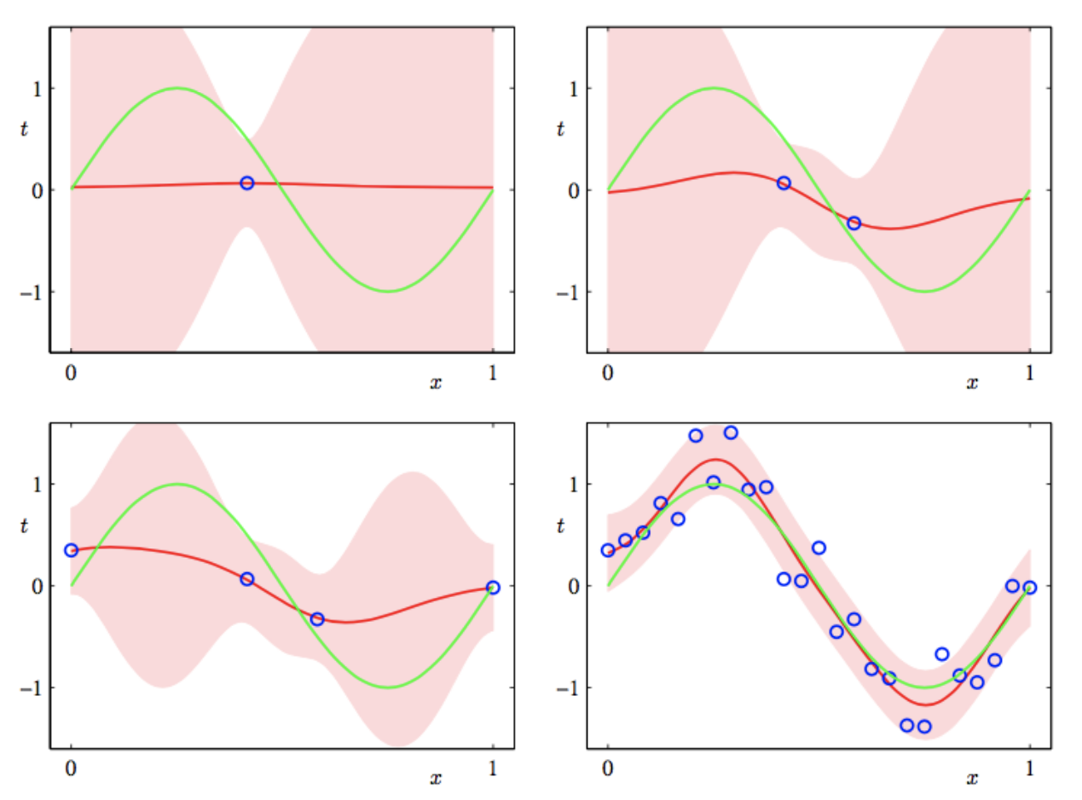
Example in regression
Pattern Recognition and machine learning, Bishop.

Slide 43


Slide 44
Thanks

Slide 45
Iris DataSet
Iris virginica
Iris setosa
Iris versicolor
Sepal
Petal
https://ca.wikipedia.org/wiki/Conjunt_de_dades_de_flors_Iris

Slide 46
Diabetes
Ten baseline variables:
age, sex, body mass index, average blood pressure, and six blood serum measurements
n = 442 diabetes patients
Target value:
A quantitative measure of disease progression one year after baseline.

Slide 47
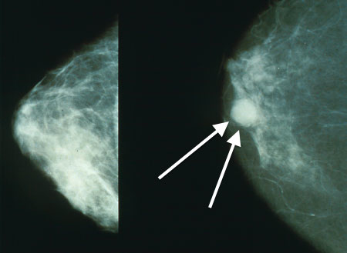
Breast cancer dataset
The breast cancer dataset is a classic and very easy binary classification dataset.
Features :
Computed from a digitized image of a fine needle aspirate (FNA) of a breast mass.
Target values:
Benign /Malignant

Slide 48
Extra useful information

Slide 49
Useful links
Installation instructions
scikit-learn
IPython
Data Sets
scikit-learn DataSet
scikit-learn: machine learning in Python :
https://scikit-learn.org/stable/
Useful cheat sheets:
https://www.analyticsvidhya.com/blog/2017/02/top-28-cheat-sheets-for-machine-learning-data-science-probability-sql-big-data/

